Slide 1
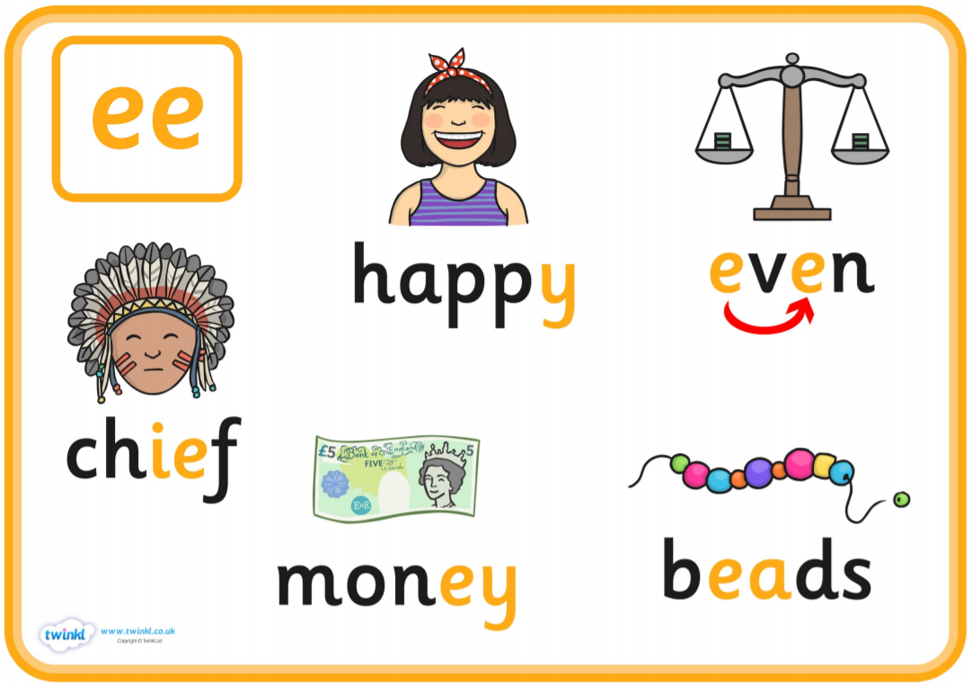

Lesson 2 – Phonics

Slide 2
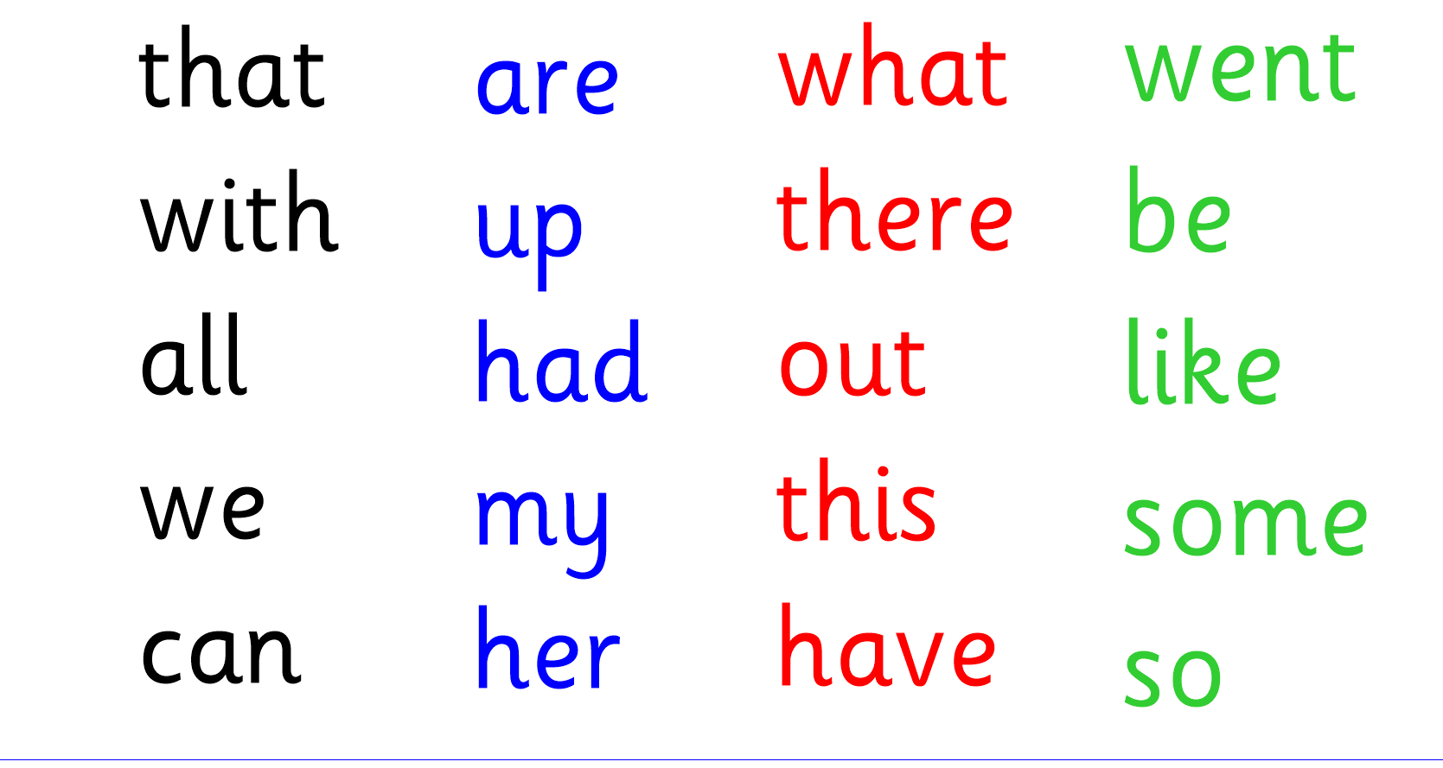
Let’s read tricky words…

Slide 3
Let’s listen to some words with the ‘ee’ sound.
Click on this link to read and listen… https://www.youtube.com/watch?v=WO1ylMaWf0w

Slide 4
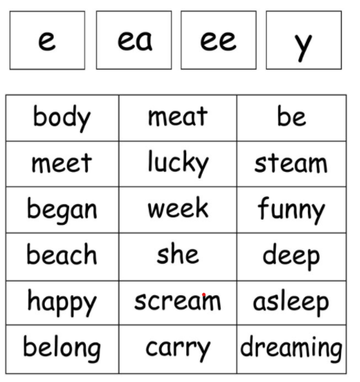
Let’s write a sentence…Choose 3 words and write a sentence.

