Slide 1

Lesson 2 – English

Slide 2

Let’s rhyme!

Slide 3
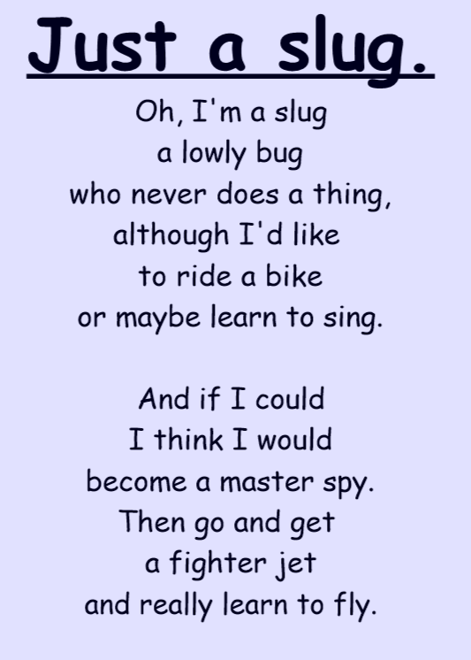
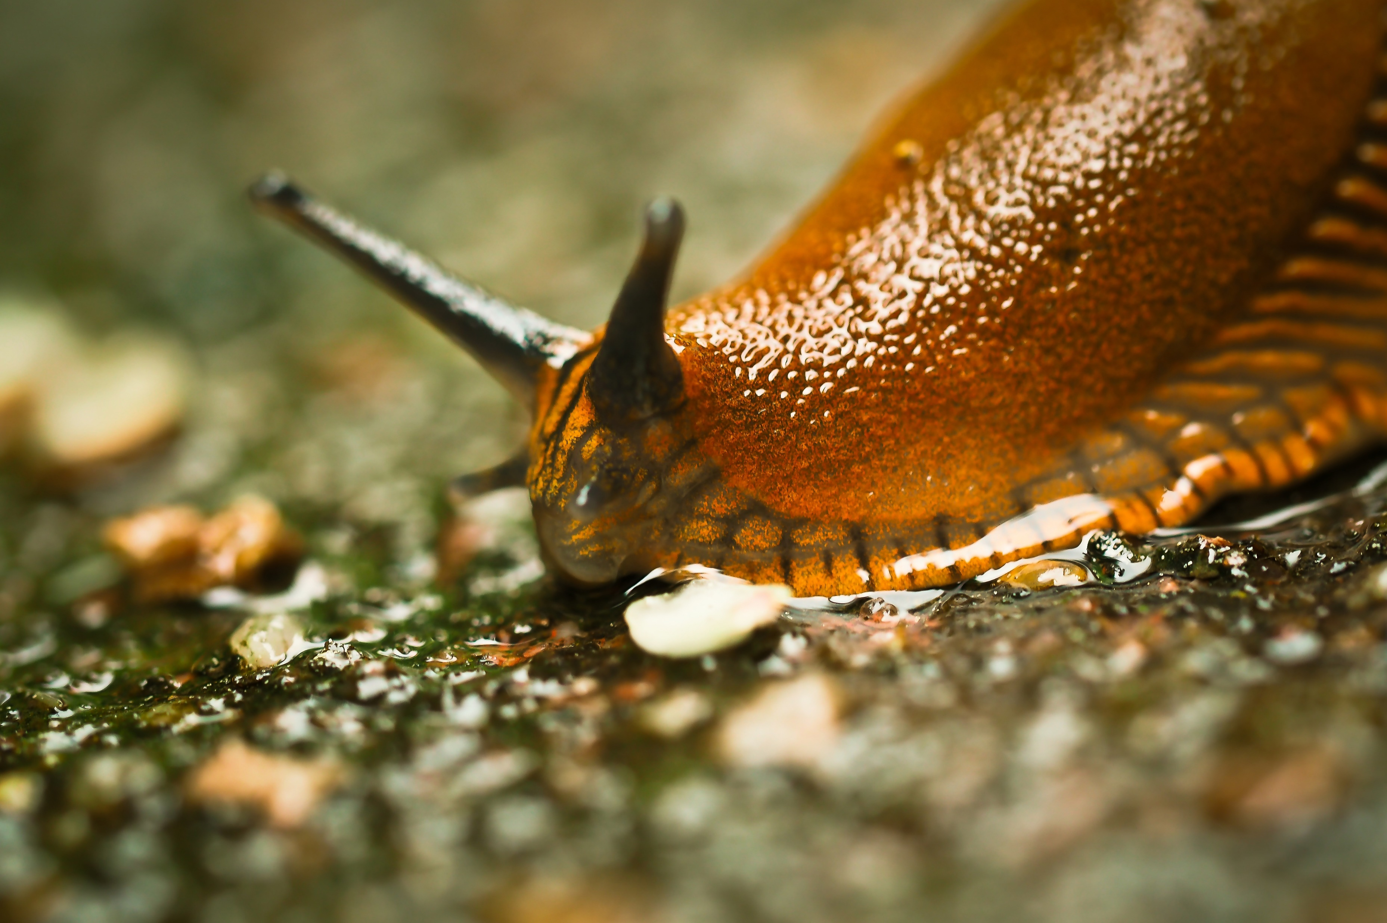
Can you see
any words that
Rhyme?

Slide 4
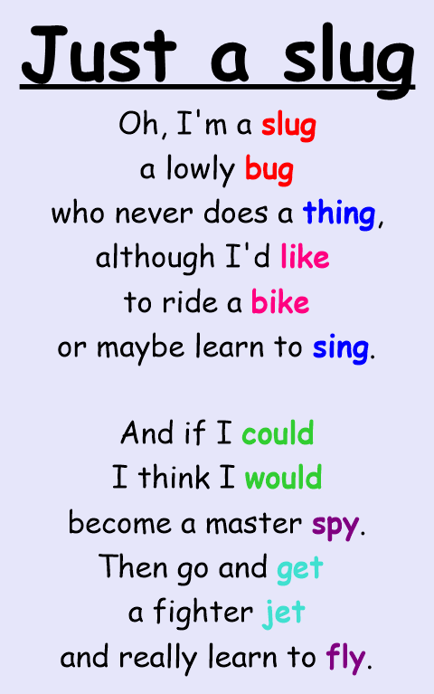

Slide 5
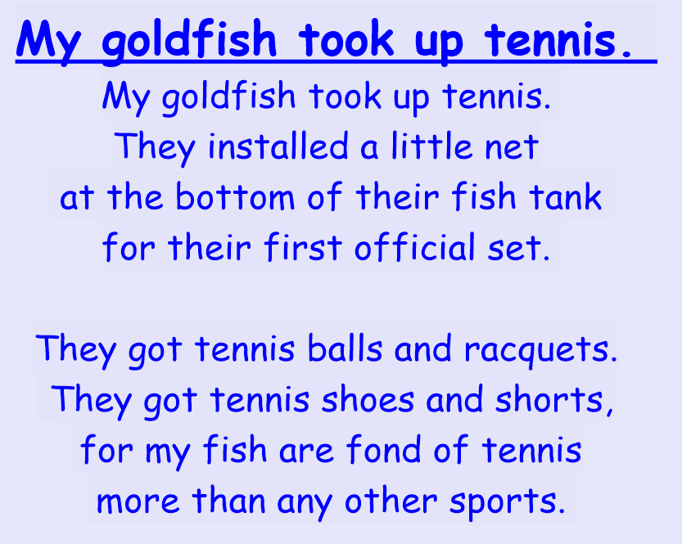
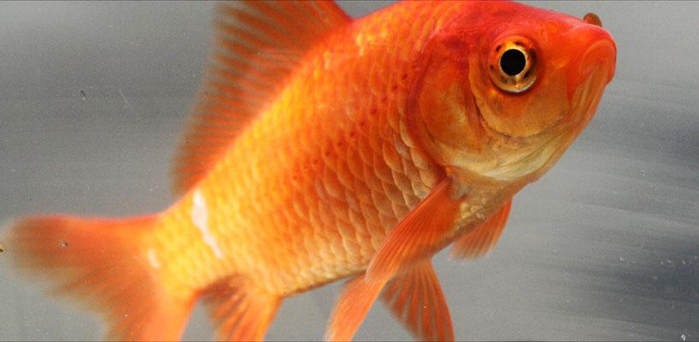
Can you see
any words that
Rhyme?

Slide 6
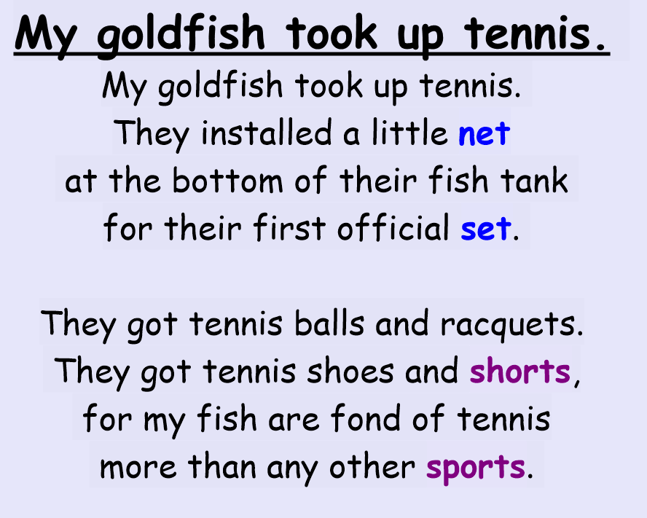

Slide 7


