Slide 1
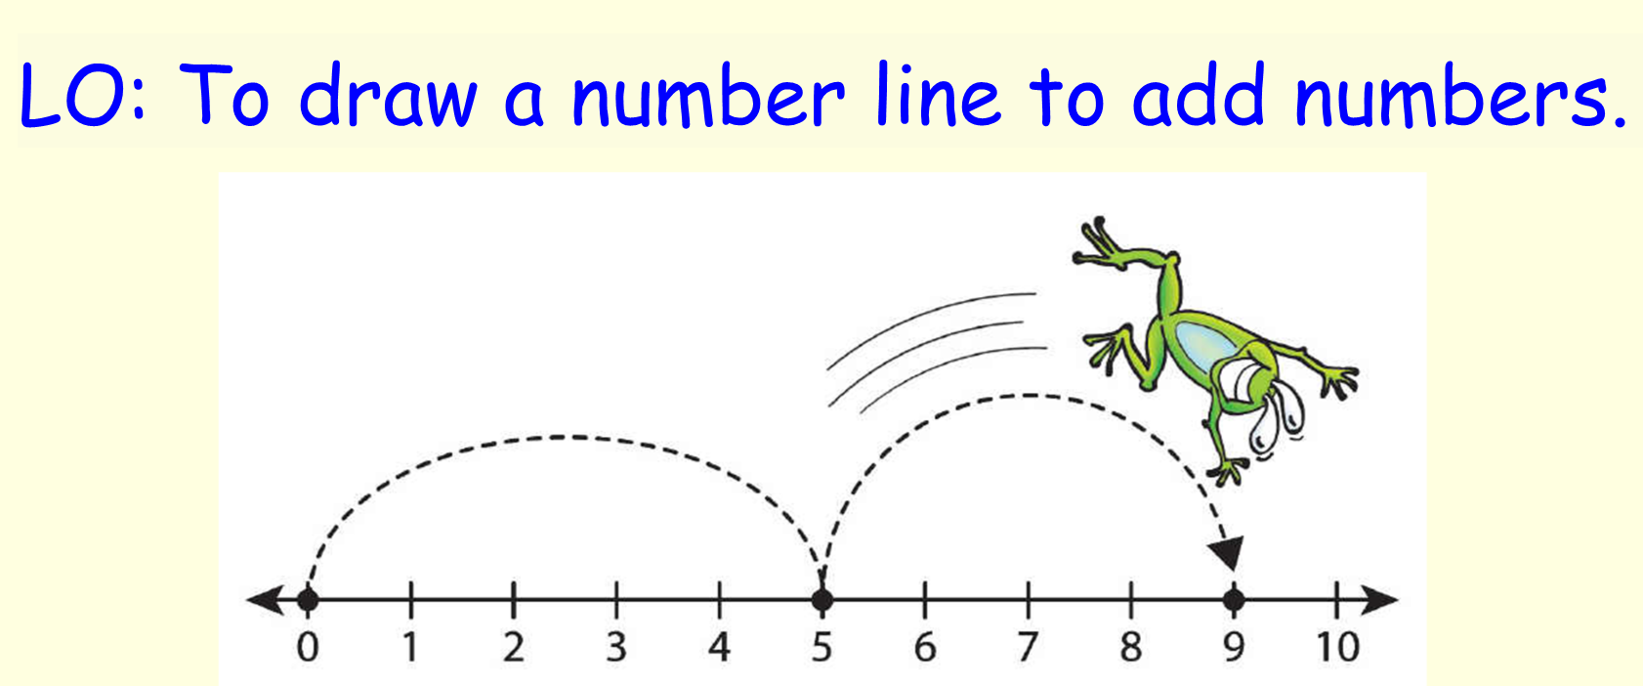

Lesson 2 – Maths

Slide 2


Slide 3
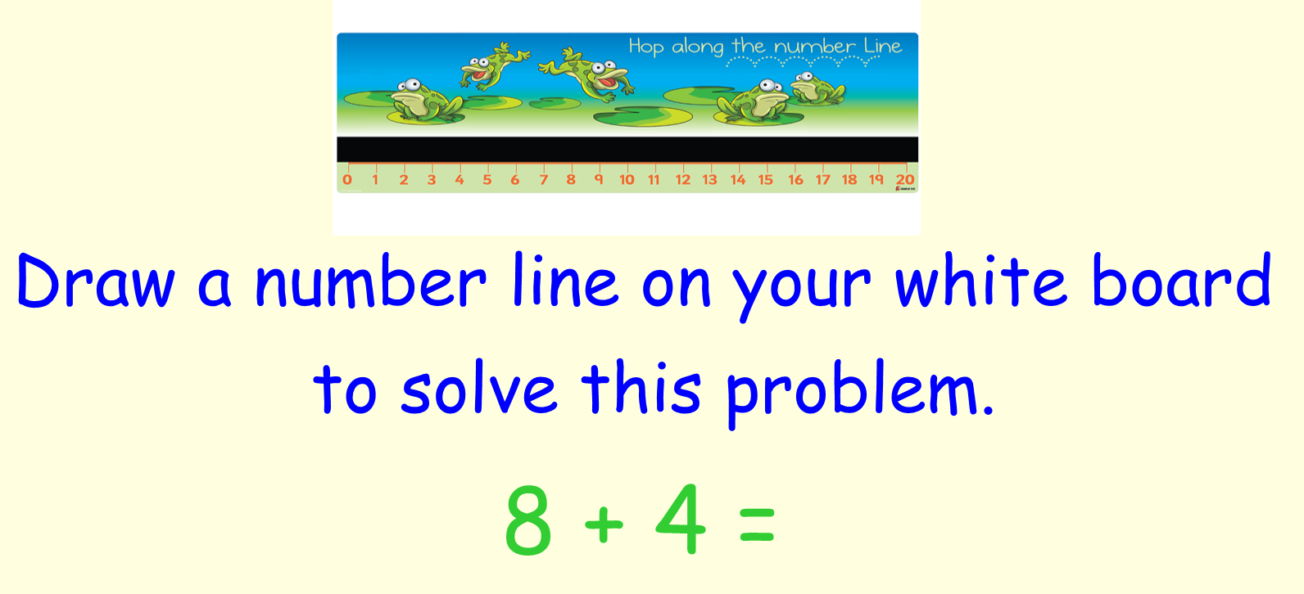




Slide 4
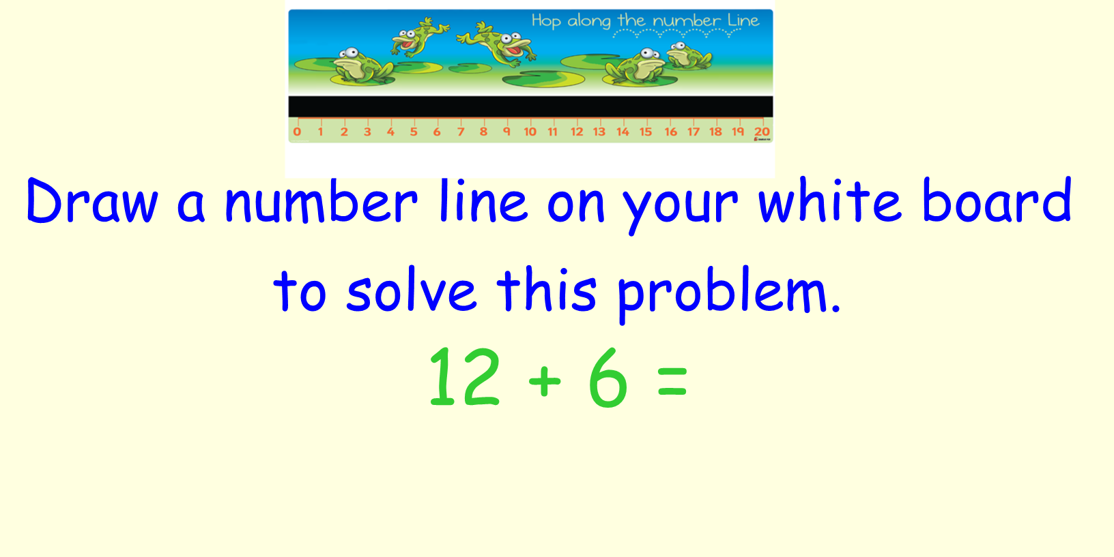



Slide 5
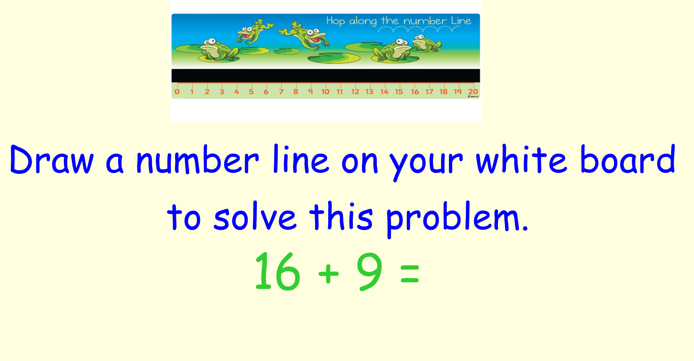

Slide 6


