Slide 1
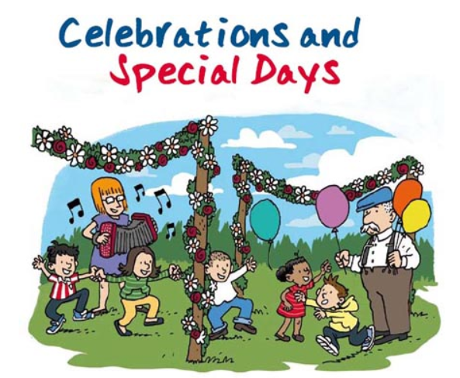
Special Celebrations

Slide 2
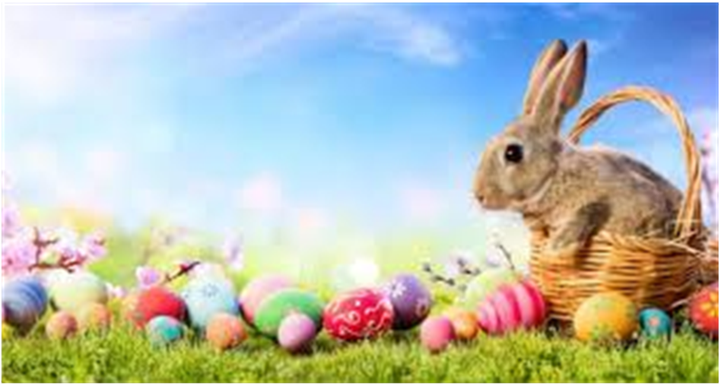
What is your favourite celebration or occasion?
Do you like Easter? Why?

Slide 3
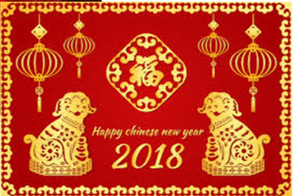
Some people celebrate
Chinese New Year.
Do you know why the Chinese people like red and gold?

Slide 4
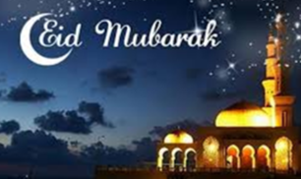
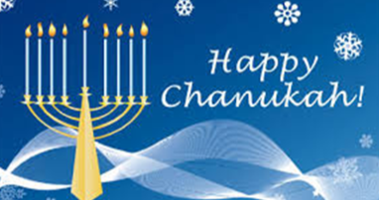
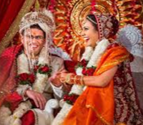
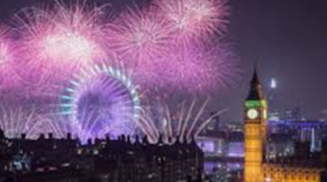
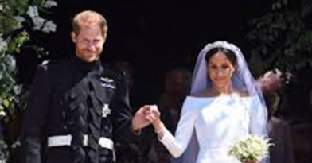
There are so many special occasions that are celebrated in our country and across the world.

Slide 5
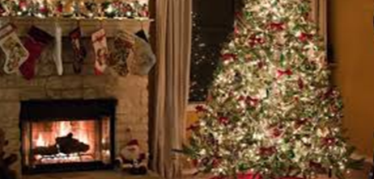
Do you like Christmas?

Slide 6
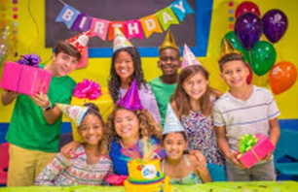
Can you think of your most important special occasion?

