Slide 1

Welcome to Year R!
Learning Together and Celebrating Success

Slide 2
What is the Early Years Foundation Stage (EYFS)?
From Birth to the end of Year R
Children learn through playing and exploring, being active and through creative and critical thinking.
Curriculum is made up of 7 areas of learning and development:
    3 Prime Areas
        Communication and Language
        Physical Development
        Personal, Social and Emotional Development
    4 Specific Areas
        Literacy
        Mathematics
        Understanding the World
        Expressive Arts and Design

Slide 3
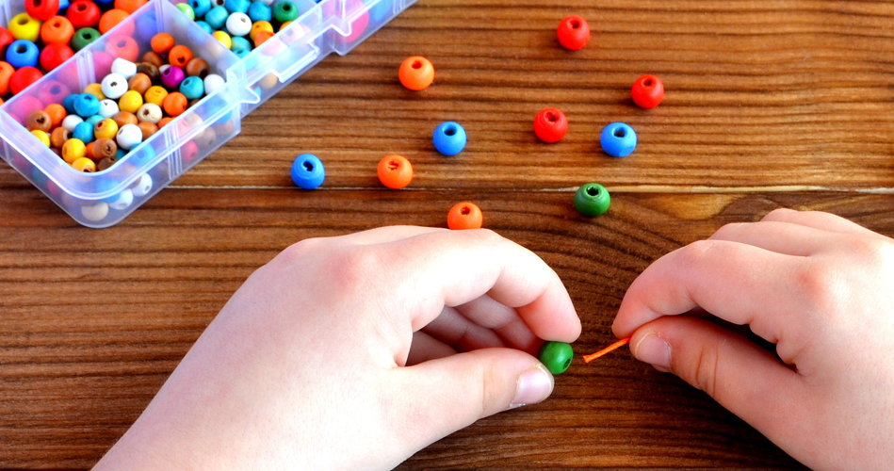
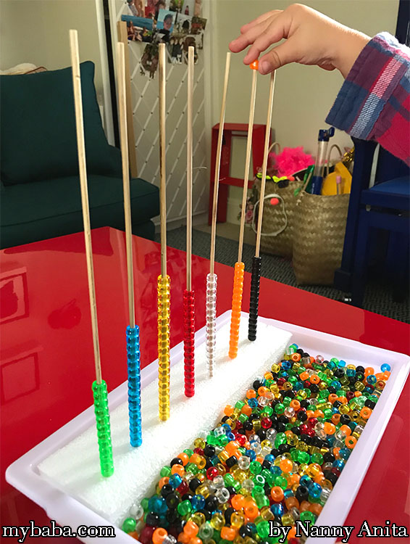
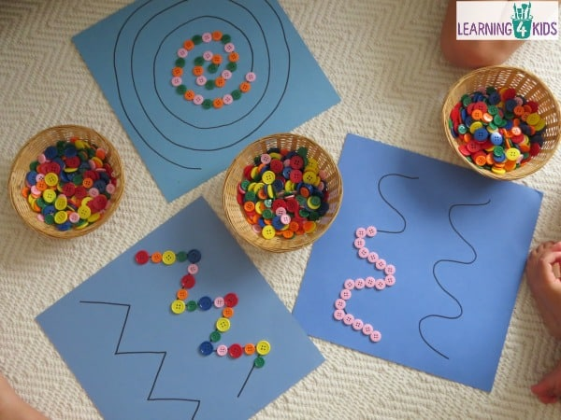
A Day in Year R
8.40 - 8.50 am Drop Off
Children can be dropped of at the Year R green gate between 8.40 and 8.50 am.
8.50 – 9.00 am Morning Activities
We begin the day with a morning activity. Each day we rotate between reading, fine motor, maths, scissors skills and pencil control/letter formation!

Slide 4
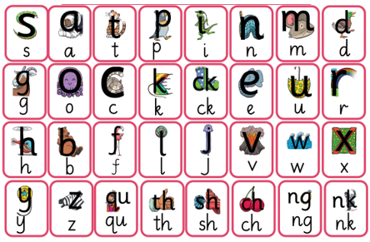
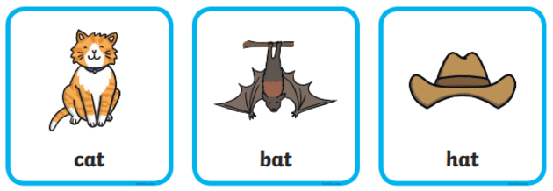
A Day in Year R
9.00 am- Phonics
We start our formal phonics lesson once the children are in full time. Here they will learn to recognise and write sounds and blend and segment words.

Slide 5

A Day in Year R
9.30 am- Assembly
We join the rest of the school for an assembly, twice a week we have assembly in our classrooms. We listen to stories, learn about different festivals and celebrations, sing and finish our week with a celebration assembly.

Slide 6

A Day in Year R
9.45 am- Morning Run and Snack time
Everyday we go out for a 10 minute run around the playground.

Slide 7

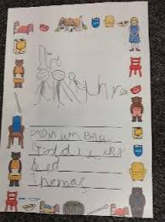
A Day in Year R
10.00 am- I’m a Clever Writer
Our Literacy planning is based around a book. We begin the year with lots of fine motor activities, then move on to tracing our names and beginning to write words. The first term focuses on letter formation.

Slide 8
A Day in Year R
10.10 am- Child- Initiated Learning
When we are not working in a group with the class teacher, then we have time to choose our own learning. We can go between the outdoor classroom, Willow and Pine Class. During this time our teachers will extend our learning through our play.

Slide 9
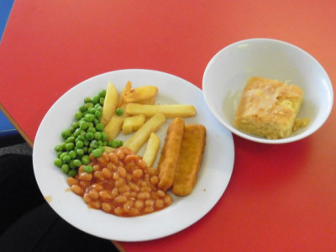
A Day in Year R
11.45 am- Lunch Time
After tidying up and washing our hands, we go down to the dining hall for our lunch. Once we have finished, we join the rest of the school in the playground.

Slide 10
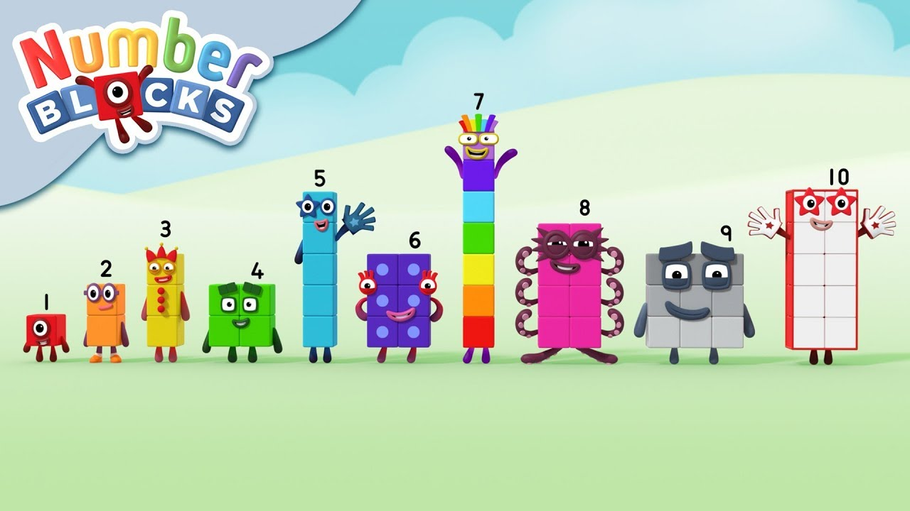
A Day in Year R
1.00pm Maths
We start are afternoons with a whole class Maths lesson. Here we learn lots about numbers!

Slide 11
A Day in Year R
1.15pm Maths Round Robin
After the input, we complete a round robin of activities. One will be a with our teacher and one with our LSA. The other three we will complete independently.
1.30pmChild- Initiated Learning
Once we have finished our round robin activities, we have time to choose our own learning. We can go between the outdoor classroom, Willow and Pine Class. During this time our teachers will extend our learning through our play.

Slide 12


A Day in Year R
2.30pm Story/Singing/Poetry Time
We tidy up and end our day listening to stories and poems and sing songs together.

Slide 13
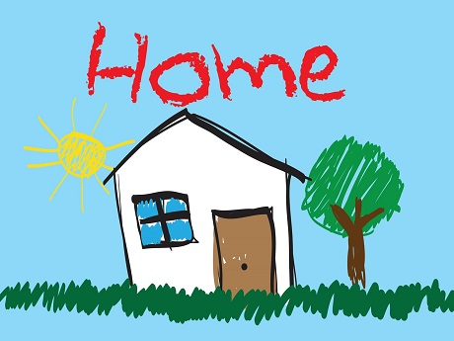
A Day in Year R
3.00pm Home Time
Willow Class to be collected from the playground by the kitchen door. Pine Class to be collected from the Year R outdoor classroom.

Slide 14
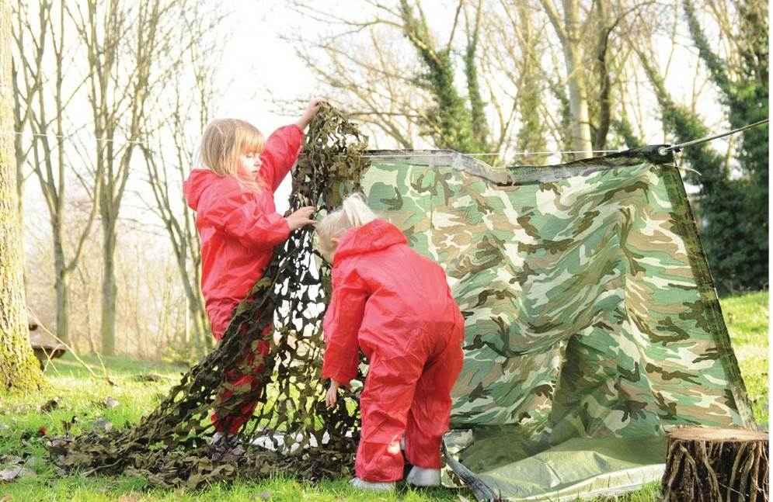
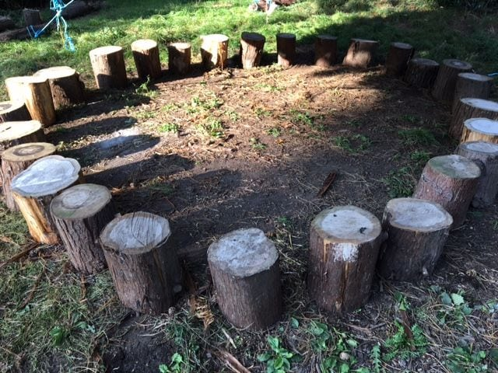
Forest School
Once a week we will spend the morning in the Environmental Area. Here we will explore the natural environment, make pies in the mud kitchen and make dens..

Slide 15
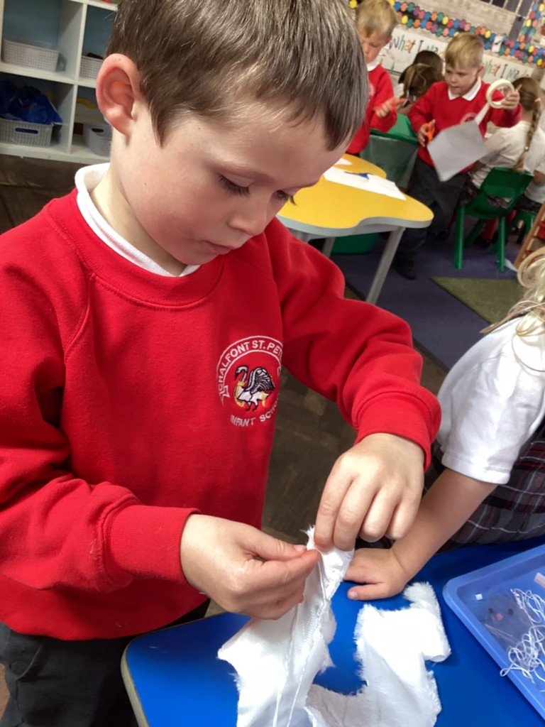
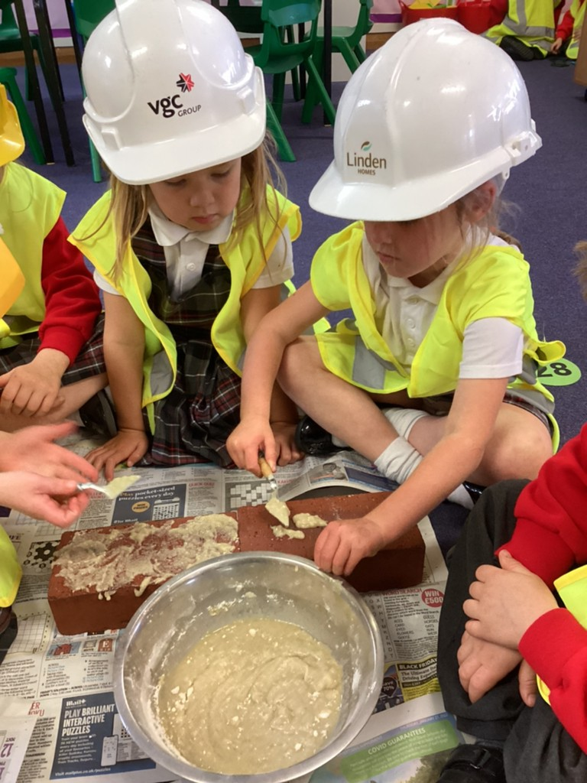
Curiosity Hour
On Friday afternoons we have Curiosity Hour, each week a child is chosen to ask a big question and we use this question to inspire our learning! This year we have been artists, builders, chefs!

Slide 16
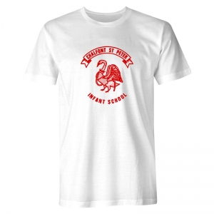
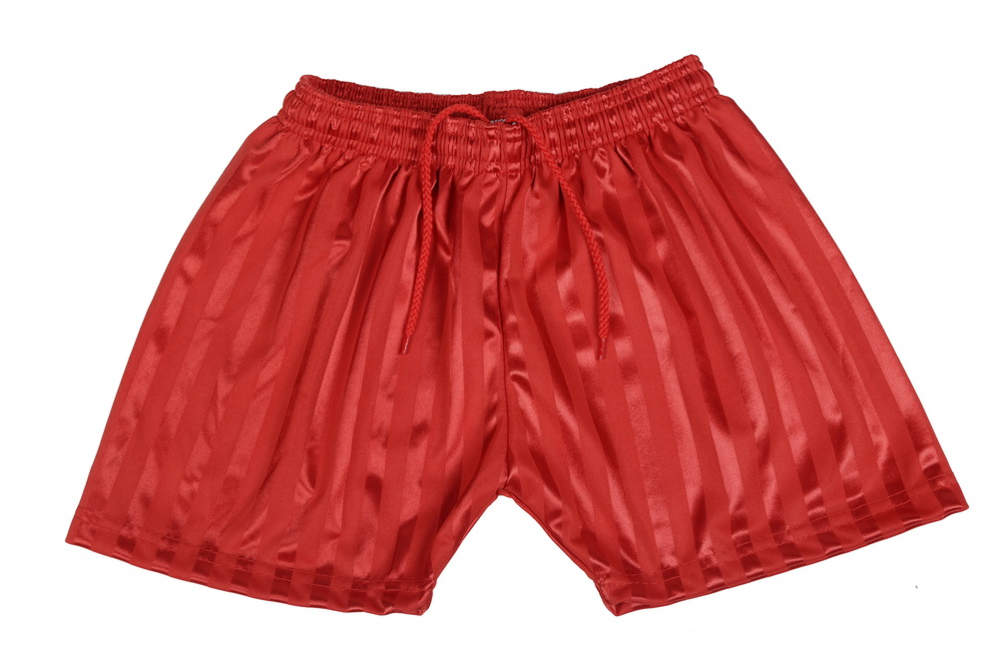
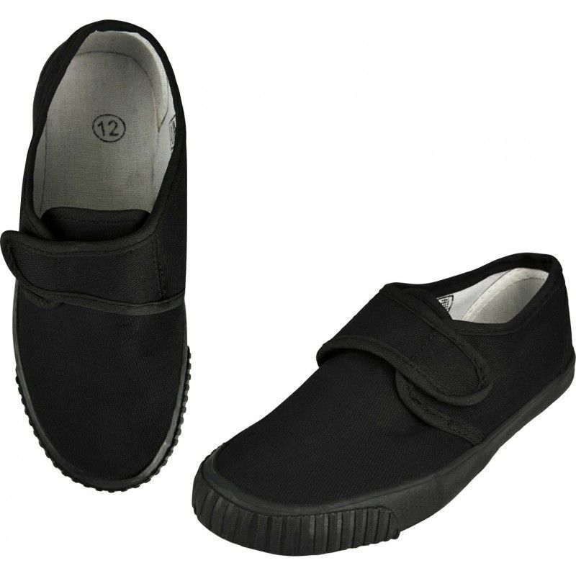
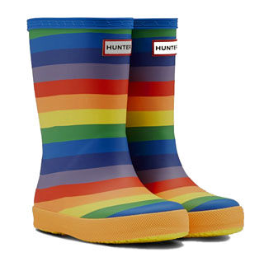
Things to be kept in school:
P.E Kit – School logo white t-shirt, red shorts, plimsolls, tracksuit bottoms. Please name all items and support your child in identifying their items. P.E kit to be kept in a named red P.E bad with school logo. This will be kept on your child’s peg.
Forest School- Long sleeved top, long trousers/leggings (PJs have worked brilliantly this year!), jumper and tracksuit bottoms, thick socks, wellies.

Slide 17
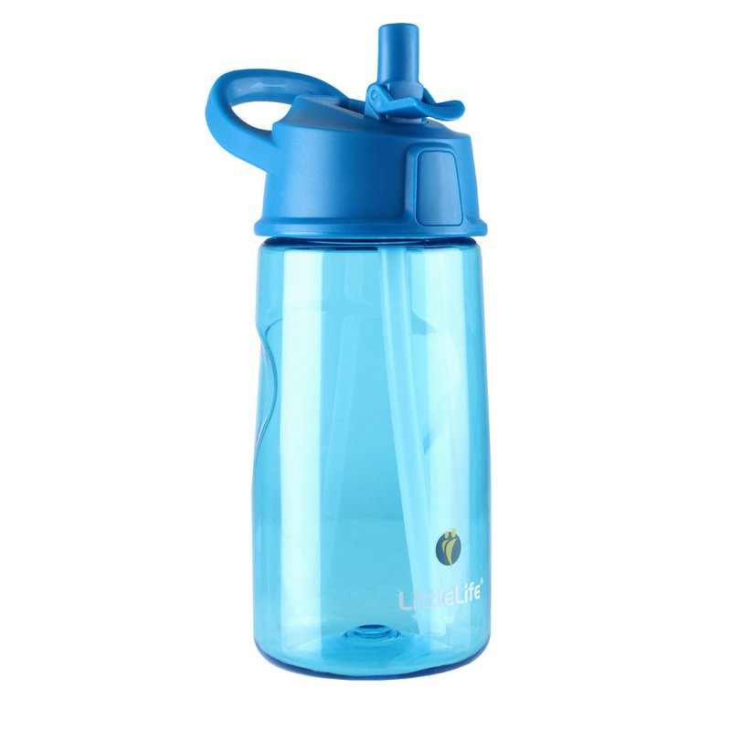

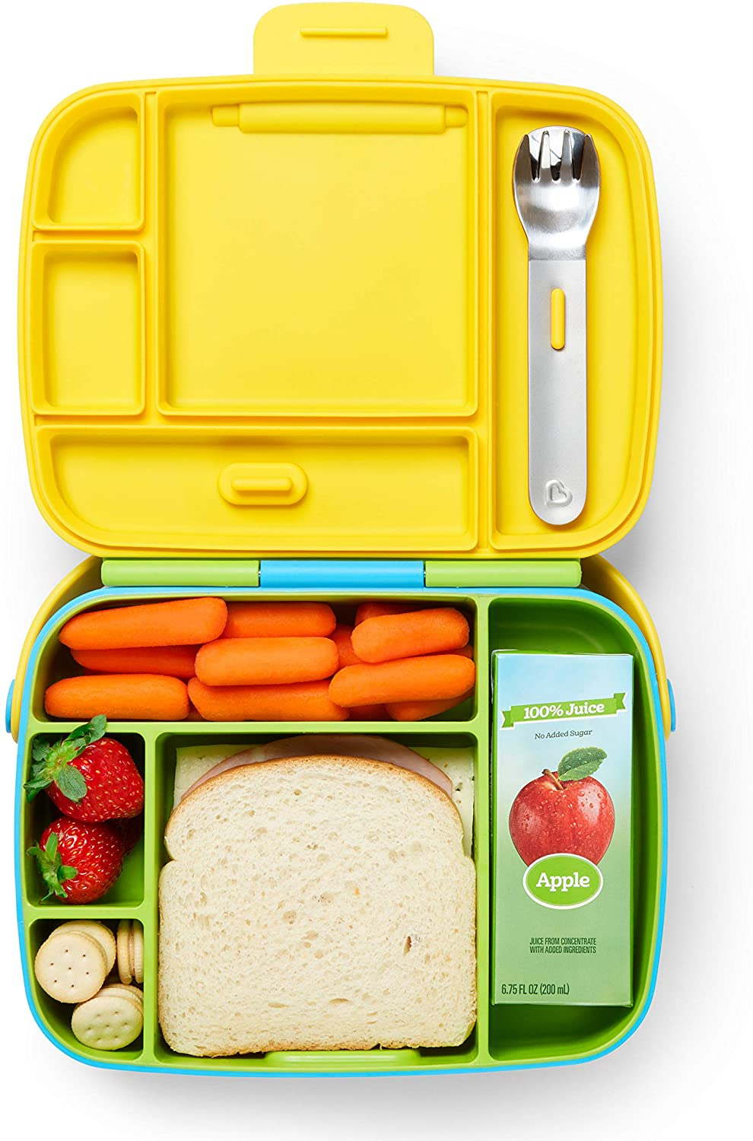
Things to bring everyday:
School Bag- Named
Folder- Will be given once your child starts school.
Reading Record- Will be given once your child starts school.
Water Bottle- Named and only containing water, no juice please.
Lunch box- If not having school lunches- please no nut products.

Slide 18
School Readiness Activities
Listening games- listen to sounds in the environment, make different animal sounds with your voice
Fine motor- to strength hands ready for writing- threading, tweezers, playdough.
Independence and Self Care- Practise putting on uniform and P.E. kit. Put on school shoes, practise recognising name and labels in clothing. Learn how to wash hands correctly and use a tissue.
Read books- There are lots of books about starting school. You could also listen to stories in our Virtual Library on the Website. We will also be adding videos to Tapestry over the summer.

