Slide 1


OUR YEAR R CURRICULUM
A journey of discovery, confidence and growing independence
Parent Curriculum Presentation
Pine Class and Willow Class
Notes:
Welcome families and introduce the idea that every part of the Year R curriculum helps children travel towards the same shared destinations.
Welcome, and thank you for coming. Tonight is really about giving you an overview of what learning looks like in Year R and how all the different parts of our curriculum fit together.
Everything we do in Year R is designed to build the knowledge, skills, confidence and independence children need for the next stage of their journey.
You’ll hear us mention things like Little Wandle, White Rose, Forest School and Curiosity Hour, but these aren’t separate parts working in isolation. They are all different routes helping children move towards our shared destinations.”
One of the most important things to understand about Year R is that learning doesn’t always look like sitting at a table with a teacher.
There is a careful balance of adult-led teaching, purposeful play, continuous provision and first-hand experiences.
Sometimes we will explicitly teach a new skill or idea. Children then need lots of opportunities to practise it, revisit it and apply it for themselves.
So if you walk into the classroom, you might see a child building, drawing, talking, digging outside or role-playing. There will often be lots of learning happening within that activity.
Our job as adults is to observe, question, model, introduce vocabulary and extend their thinking
“Everything we do in Year R is designed to build the knowledge, skills, confidence and independence children need for the next stage of their journey.”

Slide 2
How learning happens in Year R
A carefully planned balance of teaching, play and first-hand experience
ADULT-LED TEACHING
PURPOSEFUL PLAY
CONTINUOUS PROVISION
OUTDOORS AND EXPERIENCES
Teachers introduce new knowledge and model new skills.
Children practise, combine and apply their learning.
The environment helps children revisit learning independently.
Movement, investigation and real life make ideas meaningful.
Sometimes learning looks like sitting with a teacher. Sometimes it looks like building a tower, digging in the mud, writing a shop sign or sharing six conkers between three friends.
Notes:
Reassure parents that play has a clear purpose. Adults observe, teach, model and extend learning throughout the day.
Brand reference: Chalfont St Peter Little Citizens poster supplied by the user. School curriculum page: https://www.chalfontstpeterinfantschool.co.uk/curriculum-1/

Slide 3
7 Areas of Learning
Prime Areas:
Communication and Language Physical Development
Personal, Social and Emotional Development
Specific Areas:
Literacy Mathematics Understanding the World
Expressive Arts and Design
Notes:
These seven areas are interconnected. A child building outside might be developing language, mathematics, physical skills, teamwork, problem-solving and creativity all at the same time.
Explain the tree- without a strong trunk (prime areas) the branches don’t flourish (specific areas).

Slide 4
Our Year R Destinations
By the end of Year R, we want children to be:
Happy Confident Curious Independent Resilient
And developing as:
Readers Writers Mathematicians Investigators Explorers
Problem-Solvers Friends Communicators
Notes:
This is really what our curriculum is all about.
By the end of Year R, we want our children to be happy, confident, curious, increasingly independent and resilient.
Alongside that, we want them to begin seeing themselves as readers, writers, mathematicians, investigators, explorers, problem-solvers, friends and communicators.
Not every child will reach those destinations in exactly the same way or at exactly the same time, but these are the qualities we are continually developing throughout the year.

Slide 5

Communication and Language
DESTINATION: I AM A CONFIDENT COMMUNICATOR
The children will be learning to:
  talk confidently and clearly
  have conversations back and forth
  show awareness of the listener
  enjoy listening to stories, songs, poems; showing good attention
  follow instructions
  answer questions about stories
  use new vocabulary
  talk in sentences using different tenses
Notes:
Communication and language underpins almost everything children do in Year R.
We want children to become increasingly confident at expressing their ideas, listening to others and having conversations back and forth.
We work on listening carefully, following instructions, answering questions and using increasingly rich vocabulary.
Story time is really important for this because children hear vocabulary and sentence structures that they might not necessarily encounter in everyday conversation.
We also give children lots of opportunities to talk through role play, partner work, group discussions and during their play.
One of the biggest messages here is that talk is the foundation for reading, writing and learning.”

Slide 6
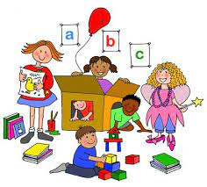
Personal, Social and Emotional Development
DESTINATION: I CAN MANAGE MYSELF AND LEARN WITH OTHERS
The children will be learning to:
  recognise and talk about emotions
  regulate themselves with support
  take turns
  resolve small disagreements
  form friendships
  persevere
  ask for help when needed
  communicate what they need
  manage their belongs
  follow routines
Notes:
A huge part of Year R is helping children learn how to manage themselves and be part of a group.
We work on recognising emotions, beginning to regulate those emotions with support, taking turns, making friendships and resolving small disagreements.
We also place a big emphasis on independence — managing belongings, following routines, knowing where things go and having a go before immediately asking an adult.
Independence doesn’t mean children never need help. It means beginning to recognise what they can do themselves and when they do need to ask for support.
We also have weekly PSHE lesons as well as weekly My Happy Mind, which supports this area.”

Slide 7
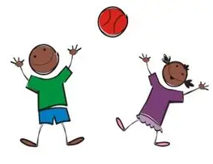
Physical Development
DESTINATION: I AM CONFIDENT IN MY BODY
The children will be learning to:
  move confidently
  negotiate space
  control their body
  handle equipment such as pencils, scissors, cutlery
  use a tripod grip
  work as a team
Notes:
Strong shoulders → strong hands → controlled fingers → confident writers
Weekly P.E lessons with a coach/ dance teacher

Slide 8

Expressive Arts and Design
DESTINATION: I AM CREATIVE
The children will be learning to:
  use a variety of materials
  share their creations and talk about the process
  use props to enhance their role play
  sing a range of songs
  explore colour mixing and different types of paint
Notes:
Weekly art activity starts after half term, children each have a sketch book
Weekly music lesson
This area gives children opportunities to express ideas in different ways.
That might be through painting, drawing, sculpture, singing, music, dancing, role play or creating models.
We want children to experiment rather than feeling there is always one correct outcome.
So we are interested in the process as well as the final product — why did they choose that material? What did they change? What worked?

Slide 9

Understanding the World
DESTINATION: I AM A CURIOUS INVESTIGATOR
The children will be learning to:
  explore and find out about the world around them
  find out about past events in their live and their families
  talk about the lives of people around them
  know similarities and differences between cultures and communities
  compare life in this country with another country
  talk about changes through the seasons
Notes:
Weekly science based lessons
Forest School
Termly topics
We look at their own lives and families, the past, different communities and cultures, the natural world and changes through the seasons.
We want children to notice things, ask questions and be interested in why things happen.
This area connects very closely with science and Forest School.

Slide 10

Reading
DESTINATION: I AM A CONFIDENT READER
The children will be learning to:
  recognise the sounds represented by letters
  blend sounds together to read words
  recognise common tricky words
  build fluency and confidence
Notes:
One of our biggest goals is for children to leave Year R seeing themselves as readers.
They learn to recognise sounds, blend those sounds together to read words and recognise tricky words that can’t always be decoded in the same way.
But reading is much more than just decoding.
We also want children to enjoy books, understand what they have read, talk about stories and become increasingly fluent.
We read aloud to children every day as well, because hearing rich stories and vocabulary is just as important as learning to decode.

Slide 11
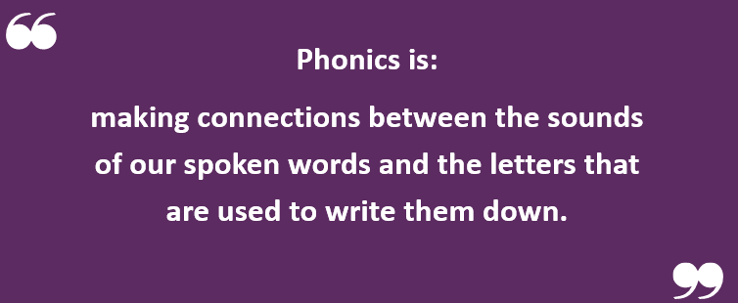
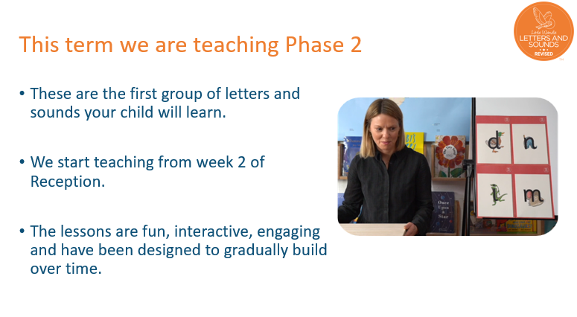
Phonics
Notes:
Phonics home learning sheets will share what we have been learning each week.
We use Little Wandle Letters and Sounds Revised as our phonics programme.
Children have phonics every day.
At the beginning, we teach children individual sounds and the letters that represent those sounds.
We then teach them how to blend those sounds together for reading and segment words into sounds for spelling.
So although it can sometimes look like children are simply learning letters, they are actually developing a whole system that they can use independently when reading and writing.”

Slide 12
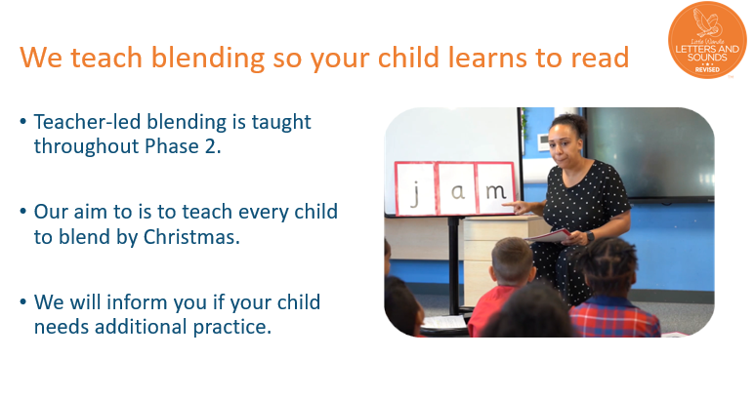
Phonics
Notes:
ne of the key skills is blending.
So rather than memorising every word, children learn that if they can recognise the sounds in a word, they can blend those sounds together.
For example, c-a-t becomes ‘cat’.
This gives them a strategy for approaching unfamiliar words.”

Slide 13
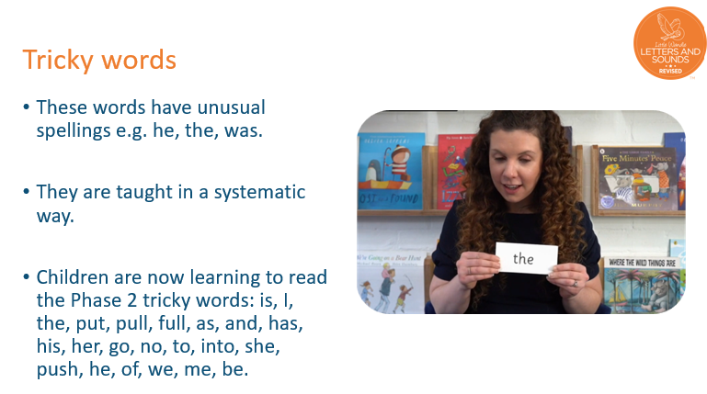
Phonics
Notes:
Alongside decodable words, children learn tricky words.
These contain a part that may not yet follow the phonics pattern they know, so we teach children which part is tricky.
The aim is for these words to become increasingly automatic when they read.”

Slide 14
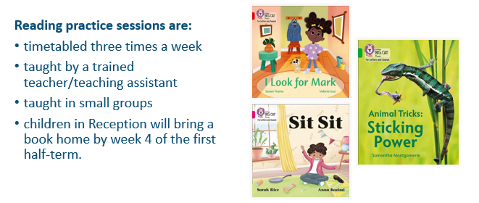
Phonics

Slide 15
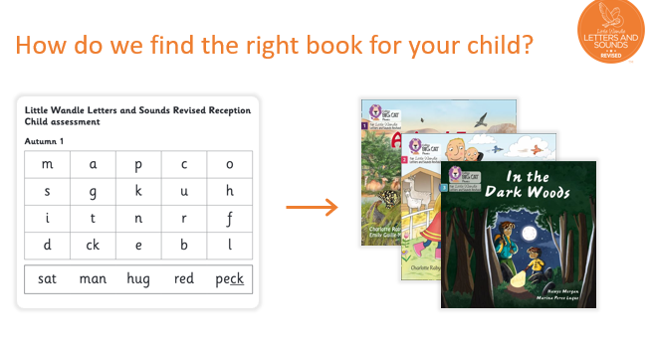
Phonics

Slide 16
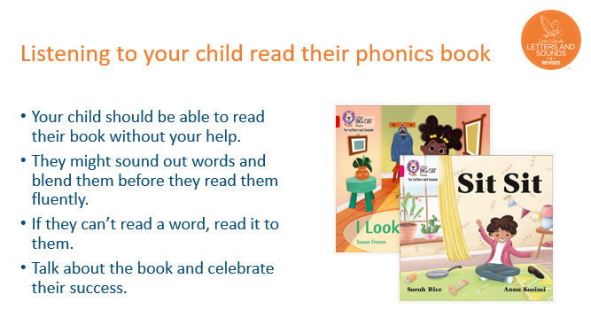
Phonics

Slide 17
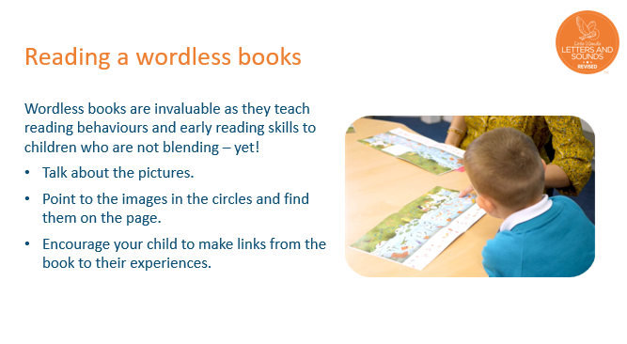
Phonics

Slide 18
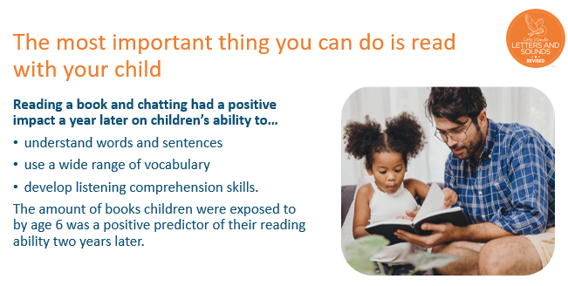
Phonics

Slide 19

Writing
DESTINATION: I AM A CLEVER WRITER
The children will be learning to:
  hear sounds within words
  choose the correct grapheme
  segment words for spelling
  use phonics independently when writing
  form letters using the correct formation
  write sentence using finger spaces and full stops
Notes:
“We want children to see themselves as writers — not children waiting for an adult to tell them every letter to write.”
Explain literacy lessons
Our writing journey begins with strong physical skills, communication and phonics.
At the moment there is a big emphasis on letter formation because we want children to develop good habits from the beginning.
We gradually move from fine motor development and letter formation, to hearing initial sounds, writing CVC words, captions and eventually sentences.
When children write independently, we encourage them to use the phonics they know rather than waiting for an adult to spell every word for them.
By the end of Year R, we want children increasingly able to form their letters correctly, use their phonics to spell and begin writing sentences using things such as finger spaces and full stops.
Most importantly, we want them to think, ‘I am a writer and I can have a go.
Big emphasis on letter formation for the term. Fine motor → Letter formation → Initial sounds → CVC words→ captions → sentences

Slide 20
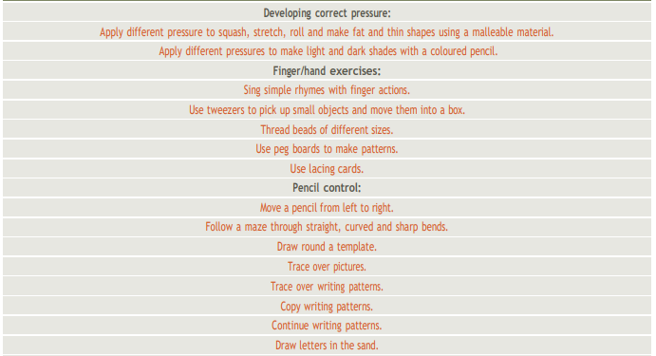
Writing

Slide 21
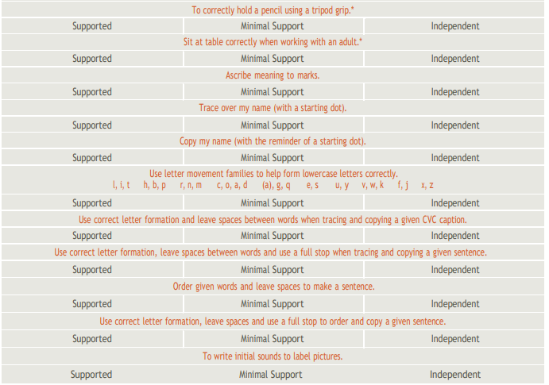
Writing

Slide 22
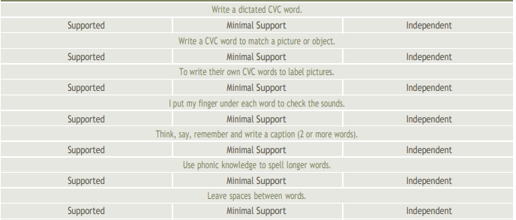
Writing

Slide 23
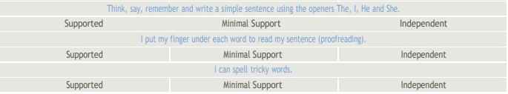
Writing

Slide 24

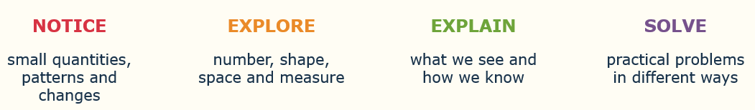
Mathematics
DESTINATION: I AM A CONFIDENT MATHEMATICIAN AND PROBLEM SOLVER
The children will be learning to:
  develop a deep understanding of number
  recognise patterns
  compare quantities
  investigate shape, space and measure
  use maths in real situations
  explain how they know
Notes:
We don’t just want children who can say the answer; we want children who can explain how they know.”
Explain maths lessons, round robin Teacher Activity → LSA activity- recapping previous lesson → 3 independent
Maths home learning sheets will share what we have been learning each week.
In maths we use White Rose to support our planning.
The most important thing in Year R is developing a really deep understanding of number.
We are not trying to rush children into working with very large numbers.
For example, understanding seven means much more than just recognising the numeral 7. We want a child to know that seven might be five and two, four and three, one more than six, or one less than eight.
We work on number, pattern, comparing quantities, shape, space and measure, and using mathematics in meaningful situations.
We also really value children being able to explain their thinking.
So rather than only asking, ‘What is the answer?’, we might ask, ‘How do you know?’ or ‘Can you show me another way?’

Slide 25
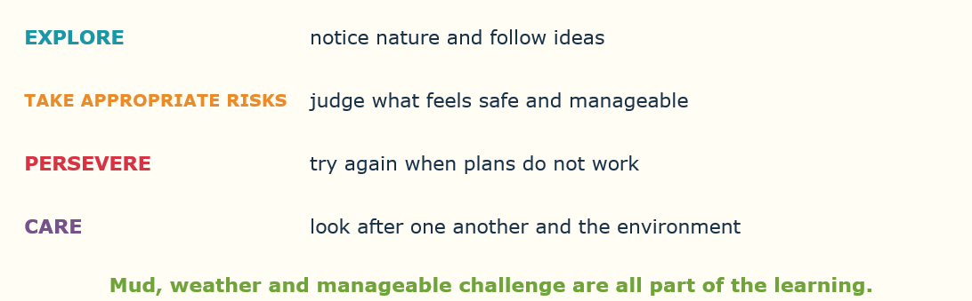
Forest School
DESTINATION: I AM A RESILIENT, INDEPENDENT AND RESPONSIBLE LEARNER
Notes:
Forest School is about much more than simply spending time outside.
It gives children opportunities to take appropriate risks, solve problems, cooperate with other children and develop confidence.
They learn that something might not work the first time and that they can adapt, try again and persevere.
They also develop an understanding of the natural world and how to care for it.
The destination isn’t a child who never finds anything difficult. It is a child who is increasingly willing to try again.”

Slide 26
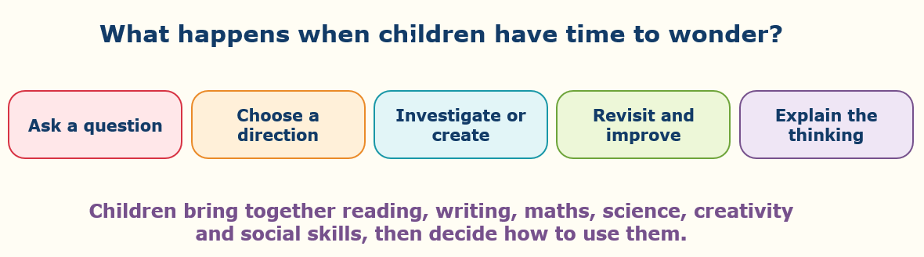
Curiosity Hour
DESTINATION: I AM A CURIOUS, INDEPENDENT LEARNER
Notes:
“Curiosity Hour is where many of our destinations come together. Children begin choosing which skills they need rather than waiting for an adult to tell them what to do.” Curiosity Hour is a really lovely opportunity for children to bring lots of their learning together.
Instead of us always deciding exactly what they are going to explore, children are given opportunities to wonder, question, investigate and make choices.
They might need to communicate with others, count something, write a label, build a structure or investigate why something has happened.
That is where we start to see children independently choosing which skills they need.
So Curiosity Hour is not separate from the curriculum — it is an opportunity to apply the curriculum

Slide 27
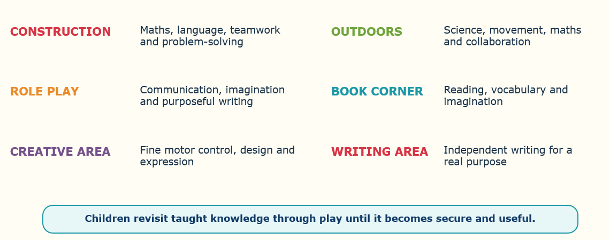
Learning Through Provision
DESTINATION: I CAN USE WHAT I KNOW
Notes:
““Provision isn't what children do when teaching has finished. Provision is part of the teaching.” Provision is what children can access throughout the classroom and outdoor environment.
Every area has a purpose.
Construction develops maths, language, teamwork and problem-solving.
Role play develops communication, imagination and purposeful writing.
The creative area develops fine motor skills, design and expression.
Outdoors gives opportunities for physical development, maths and science.
So provision isn’t what children do when the teaching has finished. Provision is part of the teaching.
It gives children repeated opportunities to practise things until they become secure enough to use them independently.”

Slide 28
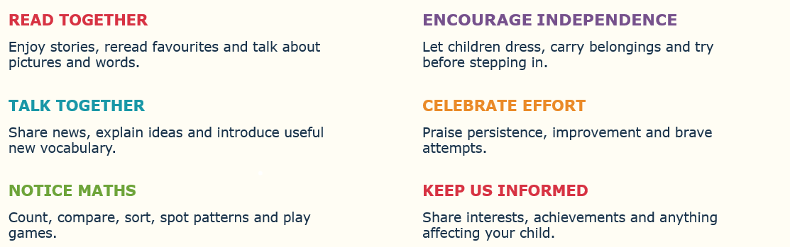
Families are part of the journey
Notes:
he partnership between school and home makes a real difference, but we also want to reassure you that you do not need to recreate school at home.
The most powerful things are often very simple.
Read together and talk about books.
Talk together about what you have done and introduce new vocabulary.
Notice maths in everyday life — numbers, patterns, quantities, shapes.
Encourage independence by letting children dress themselves, carry their own belongings and have a go before stepping in.
And celebrate effort and persistence rather than everything having to be perfect.
Please also keep us informed about interests, achievements or anything happening that may be affecting your child, because that helps us support them properly.”

Slide 29
OUR DESTINATION
Happy Curious Confident
Independent Resilient
Ready for what comes next
That is our Year R curriculum.
Questions
Notes:
I want to finish by coming back to where we started.
The aim of our Year R curriculum is bigger than children knowing a particular set of facts or completing particular schemes.
We want children to finish Year R happy, curious, confident, increasingly independent and resilient.
We want them to have strong foundations as readers, writers, mathematicians, communicators, investigators and learners.
Every child’s journey will look slightly different, and progress will happen at different rates.
But ultimately, our destination is for every child to be ready and excited for whatever comes next.
That is our Year R curriculum.”
/

